Slide 1
Lecture # 9-10
Dr. M. Nadeem

Slide 2
Linked List
Like arrays, Linked List is a dynamic linear data structure.
Unlike arrays, linked list elements are not stored at contiguous location; the elements are linked using pointers.
When we want to work with unknown number of data values, we use a linked list data structure to organize that data.
Linked list is a linear data structure that contains sequence of elements such that each element links to its next element in the sequence. Each element in a linked list is called as "Node".

Slide 3

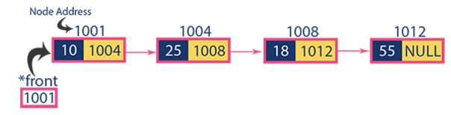
Linked List

Slide 4
The Concept Of Link List
Link list used for the dynamic memory allocation.
Array and link list both are the linear data structure.
When we want to represent several lists by using arrays of varying size, either we have to represent.
Each list using a separate array of maximum size or we have to represent each of the lists using one single array.
The first one will lead to wastage of storage, and the second will involve a lot of data movement.

Slide 5
The Concept Of Link List
A linked list is a list of elements in which the elements of the list can be placed anywhere in memory, and these elements are linked with each other using an explicit link field, that is, by storing the address of the next element in the link field of the previous element.

Slide 6
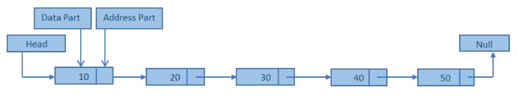
Representation of link list
Link list consists a series of structure. Each structure consists of a data field and address field.
Data field consists data part and the address field contains the address of the successors.

Slide 7
Basic Operations
Insertion − Adds an element at the start/end/any location.
Deletion − Deletes an element at from start/end/any location.
Display − Displays the complete list.
Search − Searches an element using the given key.
Delete − Deletes an element using the given key.

Slide 8
Why Linked List?
Arrays can be used to store linear data of similar types, but arrays have following limitations. 1) The size of the arrays is fixed: So we must know the upper limit on the number of elements in advance. Also, generally, the allocated memory is equal to the upper limit irrespective of the usage. 2) Inserting a new element in an array of elements is expensive, because room has to be created for the new elements and to create room existing elements have to shifted.

Slide 9
Advantages of Linked Lists
Dynamic size: They are a dynamic in nature which allocates the memory when required.
Ease of insertion/deletion: Insertion and deletion operations can be easily implemented.
Stacks and queues can be easily executed.
Linked List reduces the access time.
Efficient memory utilization. Memory is not pre allocated like static data structure. The allocation of memory depends upon the user ,i.e no need to pre-allocate memory

Slide 10
Disadvantages of Linked Lists
The memory is wasted as pointers require extra memory for storage.
Random access is not allowed. We have to access elements sequentially starting from the first node. So we cannot do binary search with linked lists.
Reverse Traversing is difficult in linked list.

Slide 11
Points to Remember
Linked lists are used when the quantity of data is not known prior to execution.
In linked lists, data is stored in the form of nodes and at runtime, memory is allocated for creating nodes.
Due to overhead in memory allocation and deallocation, the speed of the program is lower.
The data is accessed using the starting pointer of the list.

Slide 12
Applications of Linked Lists
Linked lists are used to implement stacks, queues, graphs, etc.
Linked lists let you insert elements at the beginning and end of the list.
In Linked Lists we don’t need to know the size in advance.

Slide 13
Types of Linked Lists
Singly Linked List
Doubly Linked List
Circular Linked List

Slide 14
Singly Linked List
Single linked list is a sequence of elements in which every element has link to its next element in the sequence.
In any single linked list, the individual element is called as "Node". Every "Node" contains two fields, data and next. The data field is used to store actual value of that node and next field is used to store the address of the next node in the sequence.

Slide 15
Singly Linked List
In a single linked list, the address of the first node is always stored in a reference node known as "front" Some times it is also known as "head".
Always next part (reference part) of the last node must be NULL.

Slide 16
Singly Linked List
Singly linked lists contain nodes which have a data part as well as an address part i.e. next, which points to the next node in sequence of nodes.
In this type of linked list two nodes are linked with each other in sequential linear manner. Movement in forward direction is possible.
The operations we can perform on singly linked lists are
Insertion
Deletion
Traversal.

Slide 17
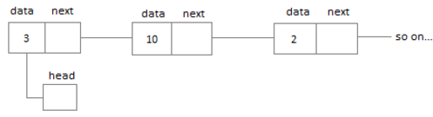
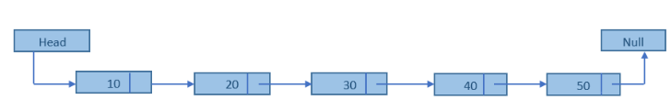
Singly Linked List

Slide 18
Circular Linked List
Circular linked list is a sequence of elements in which every element has link to its next element in the sequence and the last element has a link to the first element in the sequence.
That means circular linked list is similar to the single linked list except that the last node points to the first node in the list

Slide 19
Circular Linked List
In the circular linked list the last node of the list contains the address of the first node and forms a circular chain.
In circular linked list the first and last node are adjacent.

Slide 20
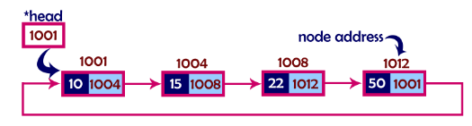
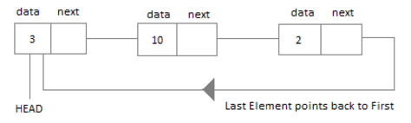
Circular Linked List

Slide 21
Doubly Linked List
In a single linked list, every node has link to its next node in the sequence. So, we can traverse from one node to other node only in one direction and we can not traverse back. We can solve this kind of problem by using double linked list
Double linked list is a sequence of elements in which every element has links to its previous element and next element in the sequence.

Slide 22
Doubly Linked List
In a doubly linked list, each node contains two links the first link points to the previous node and the next link points to the next node in the sequence.
In double linked list, every node has link to its previous node and next node. So, we can traverse forward by using next field and can traverse backward by using previous field. Every node in a double linked list contains three fields
The list can be traversed either forward or backward.

Slide 23

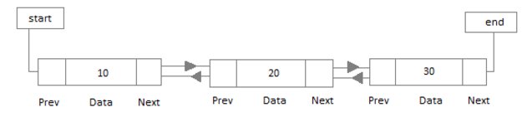
Doubly Linked List

Slide 24
Points to remember
In double linked list, the first node must be always pointed by head.
Always the previous field of the first node must be NULL.
Always the next field of the last node must be NULL.

Slide 25
Singly Link List - Insertion
In a single linked list, the insertion operation can be performed in three ways. They are as follows...
Inserting At Beginning of the list
Inserting At End of the list
Inserting At Specific location in the list

Slide 26
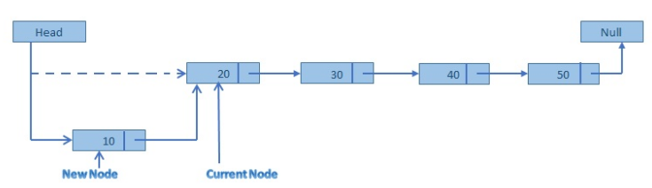
Singly Link List – Inserting At Beginning of the list

Slide 27
Singly Link List – Inserting At Beginning of the list
Step 1: Create a newNode with given value.
Step 2: Check whether list is Empty (head == NULL)
Step 3: If it is Empty then, set newNode→next = NULL
and head = newNode.
Step 4: If it is Not Empty then,
set newNode→next = head
head = newNode.

Slide 28
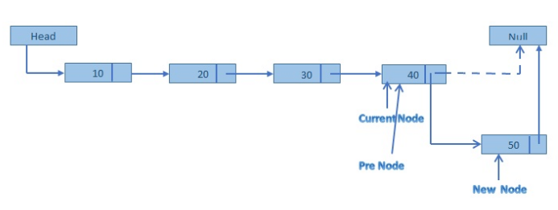
Singly Link List – Inserting At End of the list

Slide 29
Singly Link List – Inserting At End of the list
Step 1: Create a newNode with given value and newNode → next as NULL.
Step 2: Check whether list is Empty (head == NULL).
Step 3: If it is Empty then, set head = newNode.
Step 4: If it is Not Empty then, define a node pointer temp and initialize with head.
Step 5: Keep moving the temp to its next node until it reaches to the last node in the list (until temp → next is equal to NULL).
Step 6: Set temp → next = newNode.

Slide 30
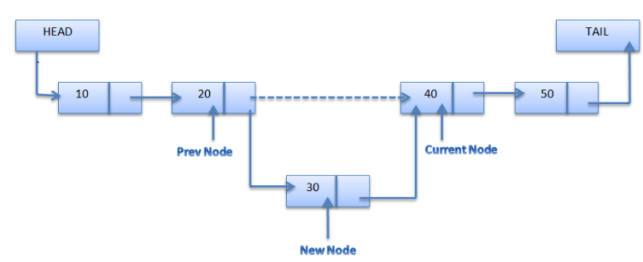
Singly Link List – Inserting At Specific location in the list (between two nodes)
Notes:
Temp is node before inserting node

Slide 31
Singly Link List – Inserting At Specific location in the list (between two nodes)
Step 1: Create a newNode with given value.
Step 2: Check whether list is Empty (head == NULL)
Step 3: If it is Empty then, set newNode → next = NULL and head = newNode.
Step 4: If it is Not Empty then, define a node pointer temp and initialize with head.
Step 5: Keep moving the temp to its next node until it reaches to the node after which we want to insert the newNode (until temp1 → data is equal to location, here location is the node value after which we want to insert the newNode).
Step 6: Every time check whether temp is reached to last node or not. If it is reached to last node then display 'Given node is not found in the list!!! Insertion not possible!!!' and terminate the function. Otherwise move the temp to next node.
Step 7: Finally, Set
'newNode → next = temp → next' and
'temp → next = newNode'
Notes:
Temp is node before inserting node

